Slide 1
Learning Invariance
Josh Grossman, Adriana Méndez Leal, and Kevin Rankine

Slide 2
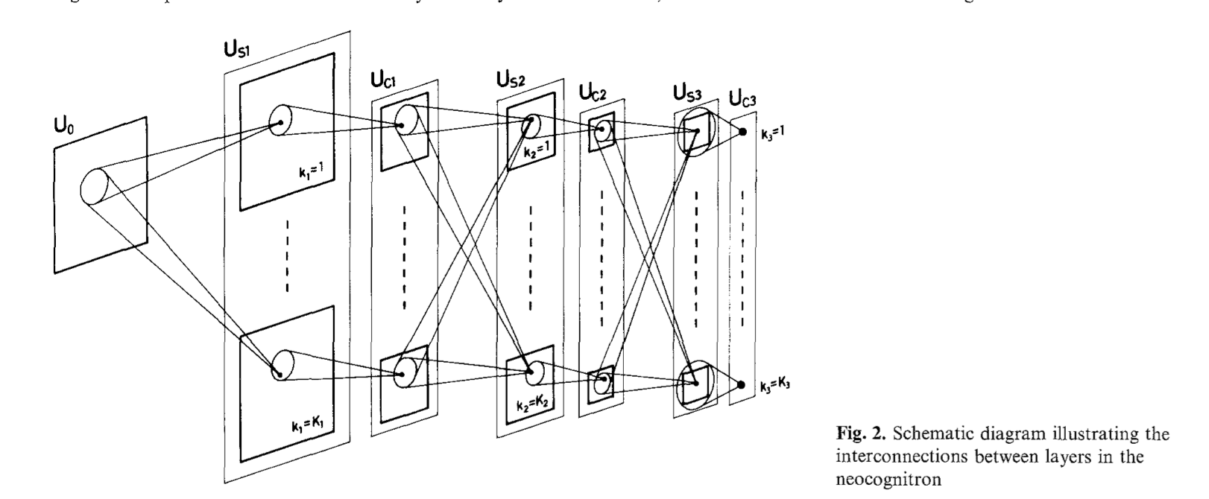
Foldiak’s Learning Rule
Hierarchical Model
Fukushima (1980)

Slide 3
Foldiak’s Learning Rule
Alternating feature detector (“S”) and invariance (“C”/complex) layers→ hierarchical structure
Simple units form adaptive connections to a complex unit (“clubs” instead of “families”)
Weight of connections determined by modified Hebbian rule

Slide 4



Foldiak vs. Hebbian Rule
Modified Hebbian:
Weight with trace:
Inhibition:
Trace accounts for previous activation, incorporates temporal continuity
Hebbian:
Where trace is 0, δ is 1
Depends only on instantaneous activation (no overlap between features)
i = complex cell number
j = simple unit number
x = 0/1 output of feature detector
y = 0/1 output of complex cell
w = strength (weight) of connection
between simple unit and complex cell
“∂” – the degree of latency

Slide 5
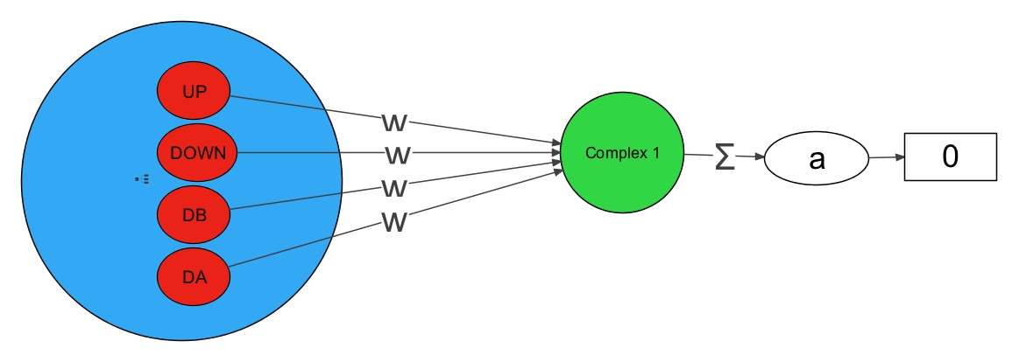
Simple Unit to Complex Cell

Slide 6
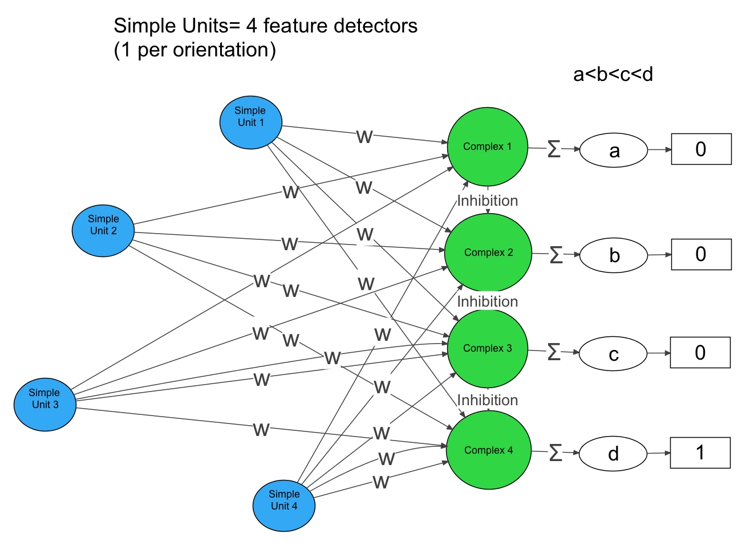

Slide 7
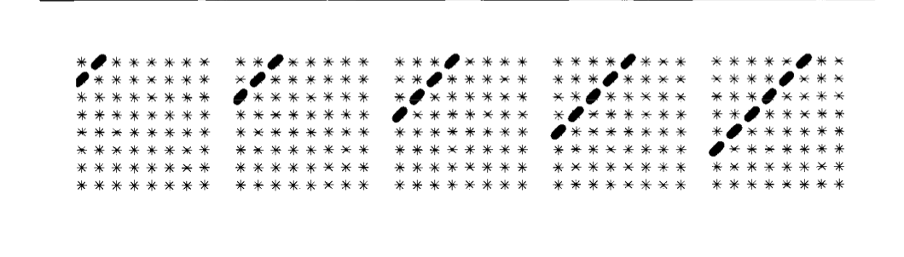
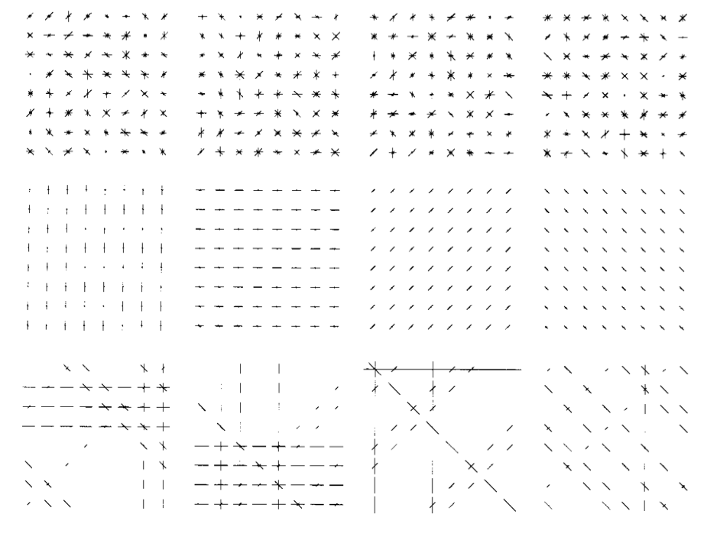
Stimulus:
Connection Patterns:
Complex Cell 1
Cell 2
Cell 3
Cell 4

Slide 8

Implementation: Stimulus

Slide 9
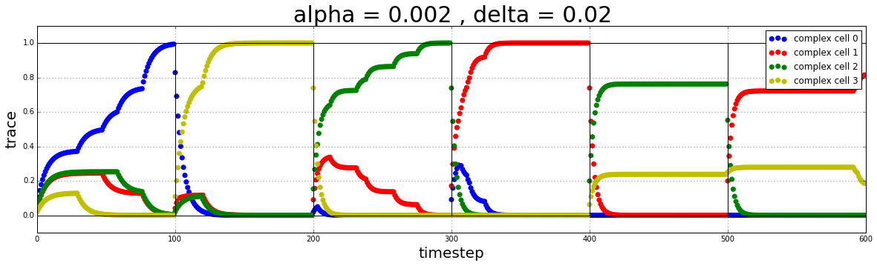
Strong trace and slow learning rate
vertical
horizontal
h2da
h2db
diagonal a
diagonal b

Slide 10
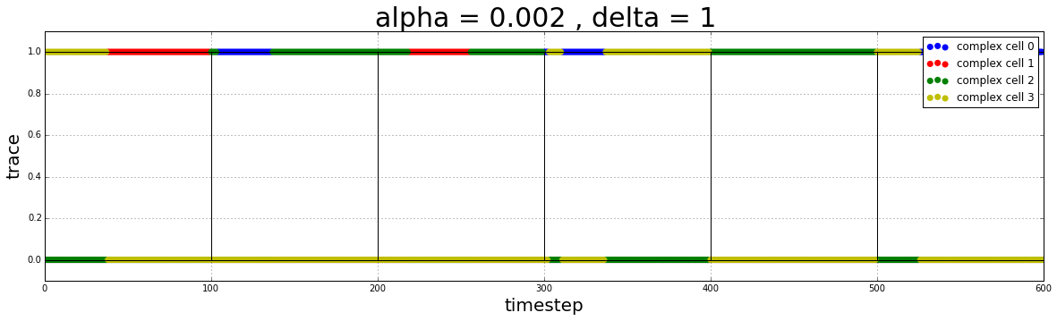
No trace (Hebbian) and slow learning rate
vertical
horizontal
h2da
h2db
diagonal a
diagonal b

Slide 11
What would happen with a weak trace?

Slide 12
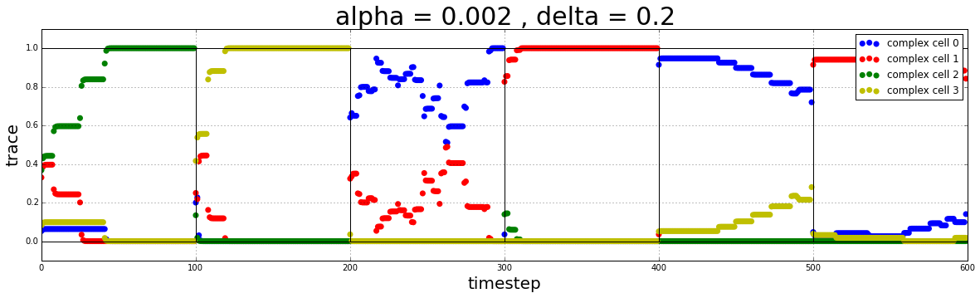
Weak trace with slow learning rate
vertical
horizontal
h2da
h2db
diagonal a
diagonal b

Slide 13
What would happen with a lower learning rate?

Slide 14
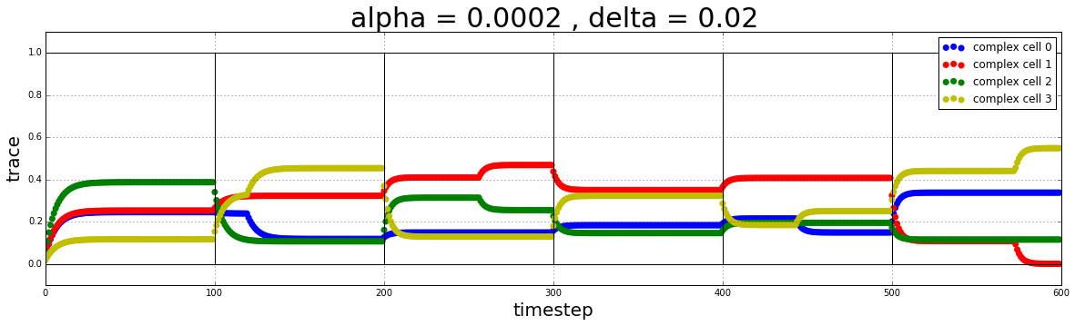
Weak trace with very slow learning rate
vertical
horizontal
h2da
h2db
diagonal a
diagonal b

Slide 15
What would happen with a weak trace and a high learning rate?

Slide 16
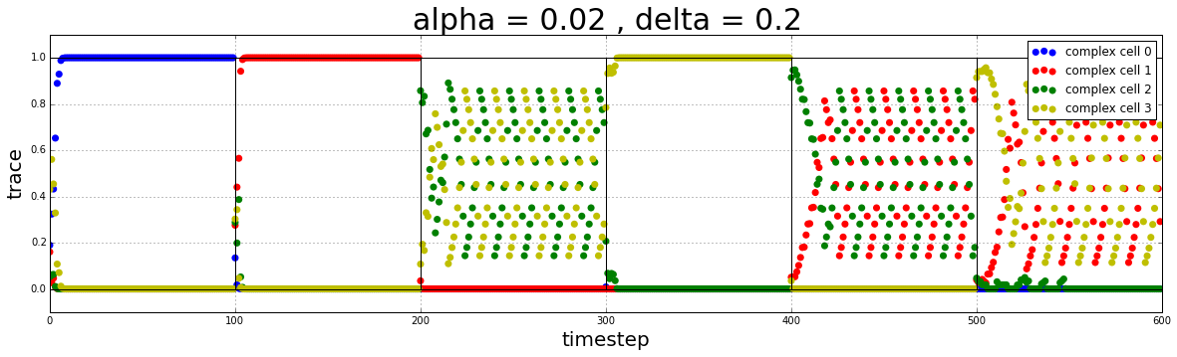
Weak trace with high learning rate
vertical
horizontal
h2da
h2db
diagonal a
diagonal b

Slide 17
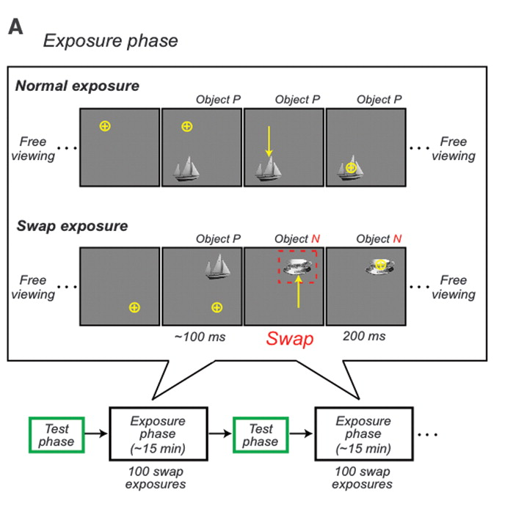
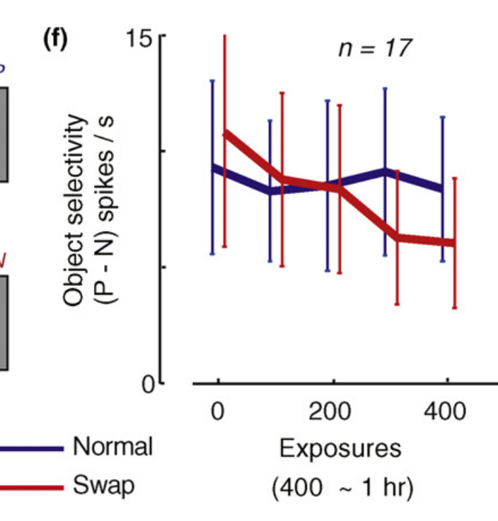
Evaluating the Model: DiCarlo & Li
Temporal contiguity: Reduced object selectivity at swap position (position specific). Objects associated in time have decreased difference in neural response in IT neurons (P decrease and N increase).
Notes:
Natural stability (slowness) of objectidentity instructs learning that occurs without external supervision– which is why longer fixating exposure times had stronger hange effects

Slide 18
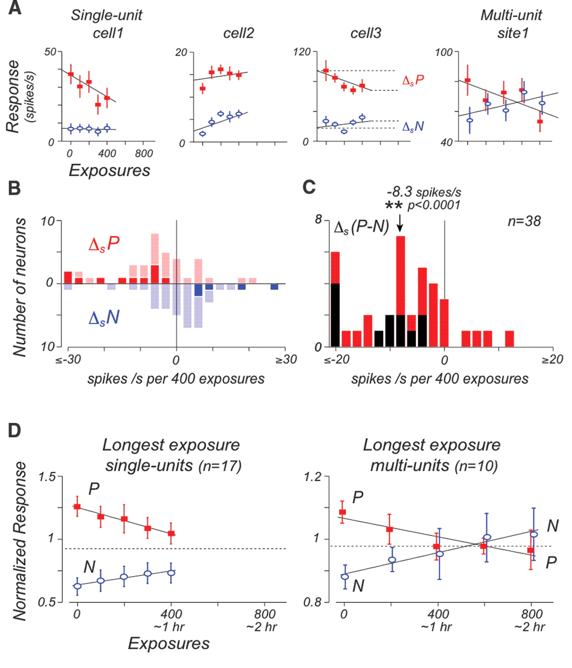
Evaluating the Model: DiCarlo & Li
Unsupervised Temporal Slowness Learning (UCL) as a mechanism for invariance
Notes:
Temporal contiguity: Reduced object selectivity at swap position (position specific). Objects associated in time have decreased difference in neural response in IT neurons (P decrease and N increase).

Slide 19
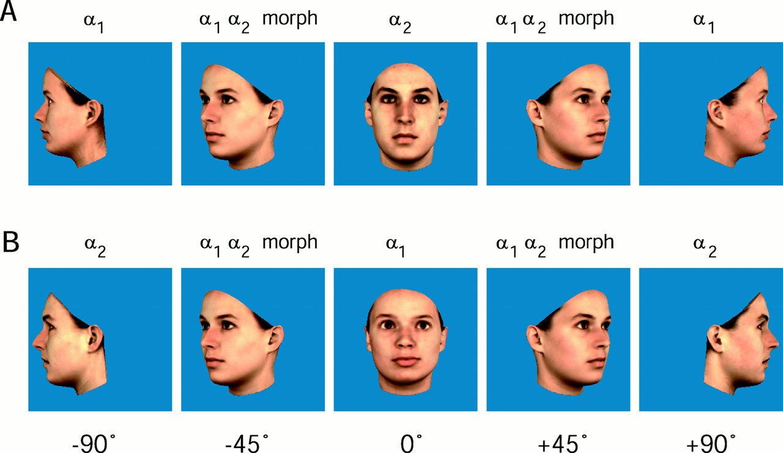
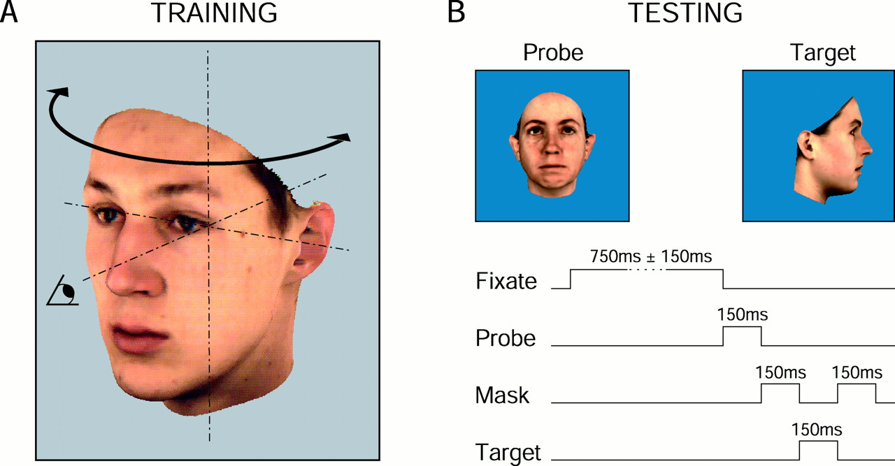
Evaluating the Model: Wallis & Bulthoff
Experiment 1: associate face with different profile, discrimination task (WG and BG)
Experiment 2:Morphs presented simultaneously (not in order)
Experiment 3: Experiment 1 with randomized order of head views
Experiment 4:Veridical+morphs, indicate if the face has changed. One group exposed to morphs before testing

Slide 20
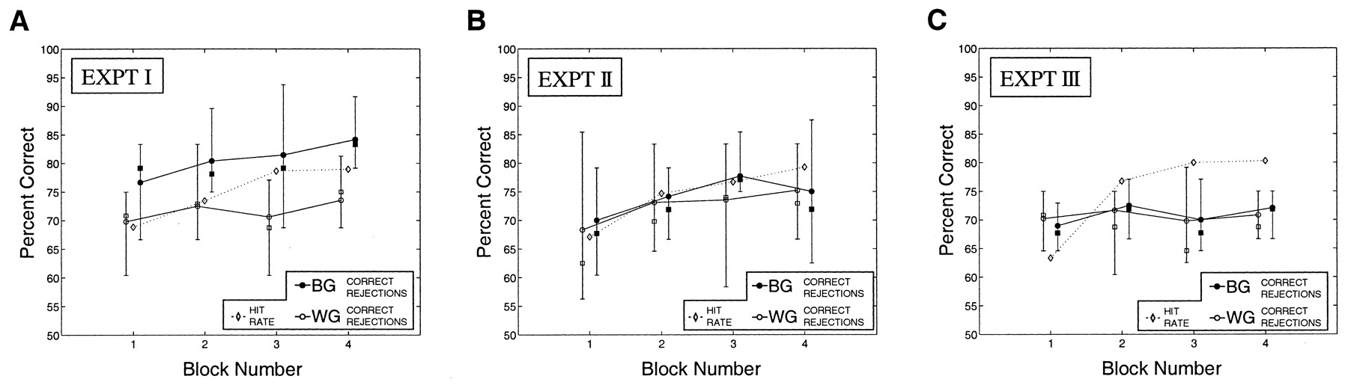
Evaluating the Model: Wallis & Bulthoff
EXPT 4: Untrained group could distinguish, pre-exposed group had trouble with discrimination
Suggests objects are represented as many two dimensional views
Spatiotemporal continuity (and not just temporal) affects invariance, although
somewhat inconclusive

Slide 21
With this evidence in mind, how could we improve/extend Foldiak’s model?

Slide 22
What are the limitations of Foldiak’s model?

Slide 23
How could you extend the model to a continuous time scale?

